Slide 1
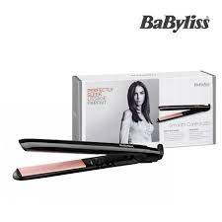
Digital Marketing Strategy For Babyliss

Slide 2
01
02
Table of contents
03
04
05
Introduction
Strategy Objectives and KPIs
Digital Strategy Research
Developing a Creative Strategy
Executing a Digital Marketing Strategy

Slide 3
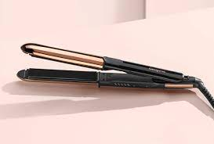
Introduction
01

Slide 4
Our Product
Babyliss is a leading manufacturer of professional hair styling tools. Babyliss products are designed to help you achieve the perfect hair style, whether you are looking for sleek and straight hair, voluminous curls, or anything in between. With Babyliss, you can create salon-quality looks at home with ease.

Slide 5
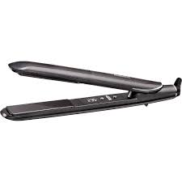
Strategy Objectives and KPIs
02

Slide 6
The first step in any digital marketing strategy is to set goals and objectives. What do you want to achieve with your digital marketing efforts? Do you want to increase brand awareness, generate leads, or drive sales? Once you know your goals, you can develop key performance indicators (KPIs) to measure your progress.
Objectives and KPIs for Babyliss could include:
Increase brand awareness by 10% within 6 months
Generate 1,000 leads within 3 months
Drive $100,000 in sales within 12 months

Slide 7
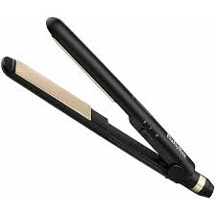
Digital Strategy Research
03

Slide 8
Once you know your goals and KPIs, you need to do some research to understand your target audience and the digital landscape. Who are your target customers? Where do they spend their time online? What are their interests? What are their pain points?
Target Audience:
Babyliss's target audience is women aged 18-54 who are interested in hair styling. They are typically active on social media and are looking for products that are easy to use and give them salon-quality results

Slide 9
Developing A Creative Strategy
04

Slide 10
Strategy Channels
The Strategy channels that will be used to reach the target audience include:
Search engine marketing (SEM)
Social media marketing (SMM)
Content marketing (CM)
Email marketing (EM)
Strategy Budget
The Strategy budget for this campaign is $100,000.
The budget will be allocated as follows:
SEM: 50%
SMM: 30%
CM: 15%
EM: 5%

Slide 11
Strategy Tactics
The following Strategy tactics will be used to reach the target audience:
SEM: Babyliss will use SEM to place ads on search engines such as Google and Bing. The ads will target keywords related to hair styling, such as "hair dryer" and “babyliss.“
SMM: Babyliss will use SMM to connect with its target audience on social media platforms such as Facebook, Twitter, and Instagram. The brand will share its content on social media, interact with its followers, and participate in relevant conversations. Babyliss will also use social media to run contests and giveaways to generate excitement and buzz around its products
CM: Babyliss will create and share high-quality content that is relevant to its target audience. This content will include blog posts, infographics, videos, and social media posts. The content will focus on hair styling tips, product reviews, and behind-the-scenes looks at the Babyliss brand.
EM: Babyliss will collect email addresses from its website visitors and use email marketing to stay in touch with them. The brand will send its subscribers news, updates, and special offers.

Slide 12
Executing A Digital market strategy
05

Slide 13
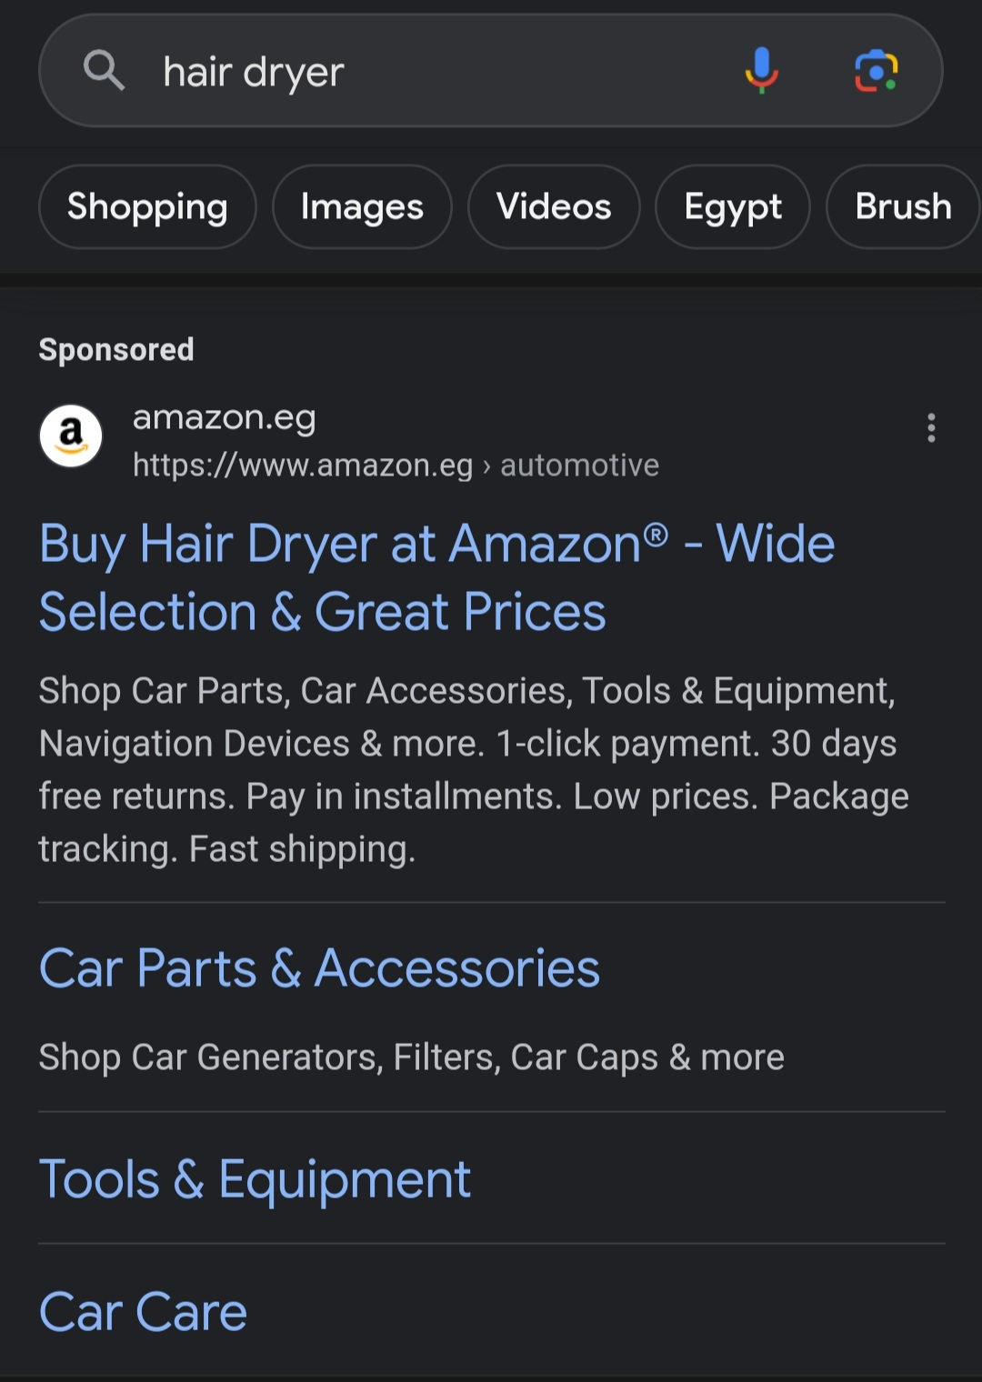
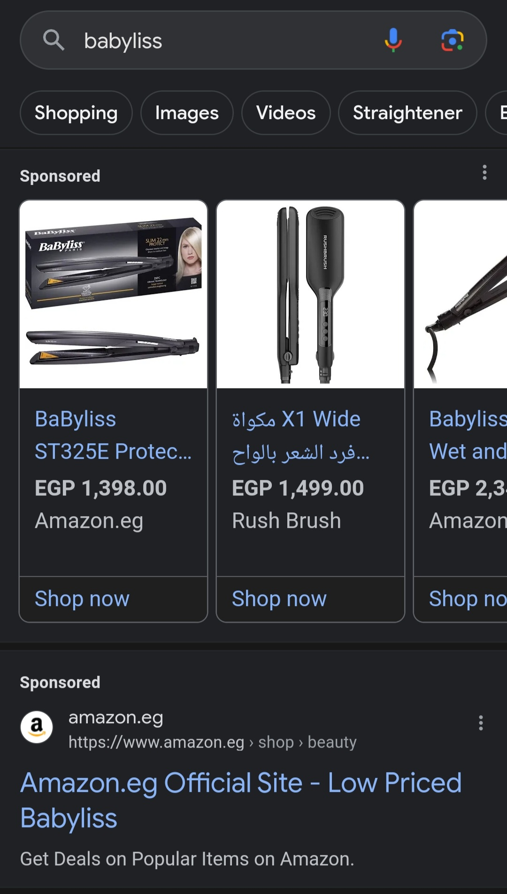
Search Engine Marketing:

Slide 14
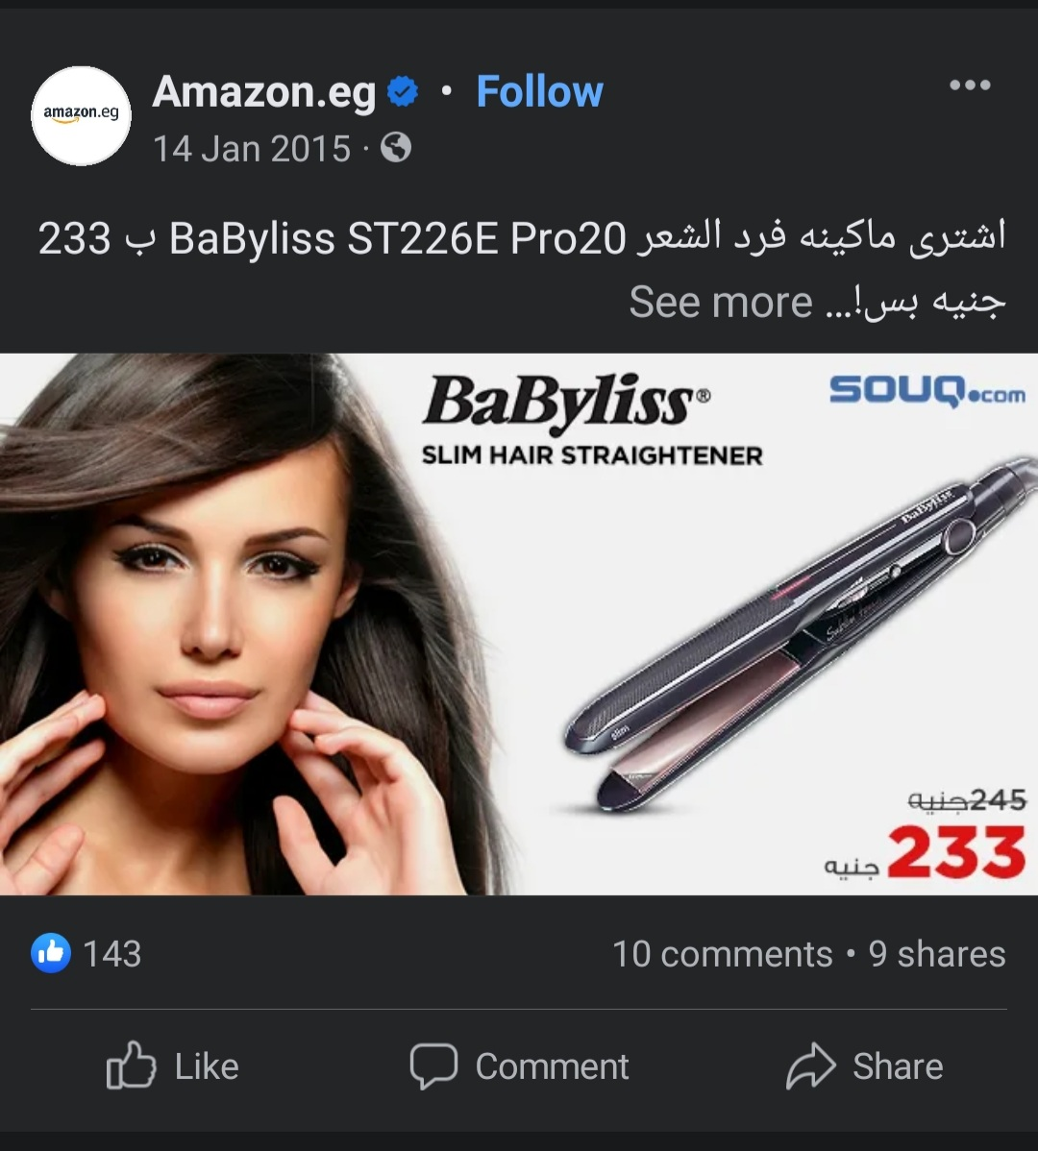
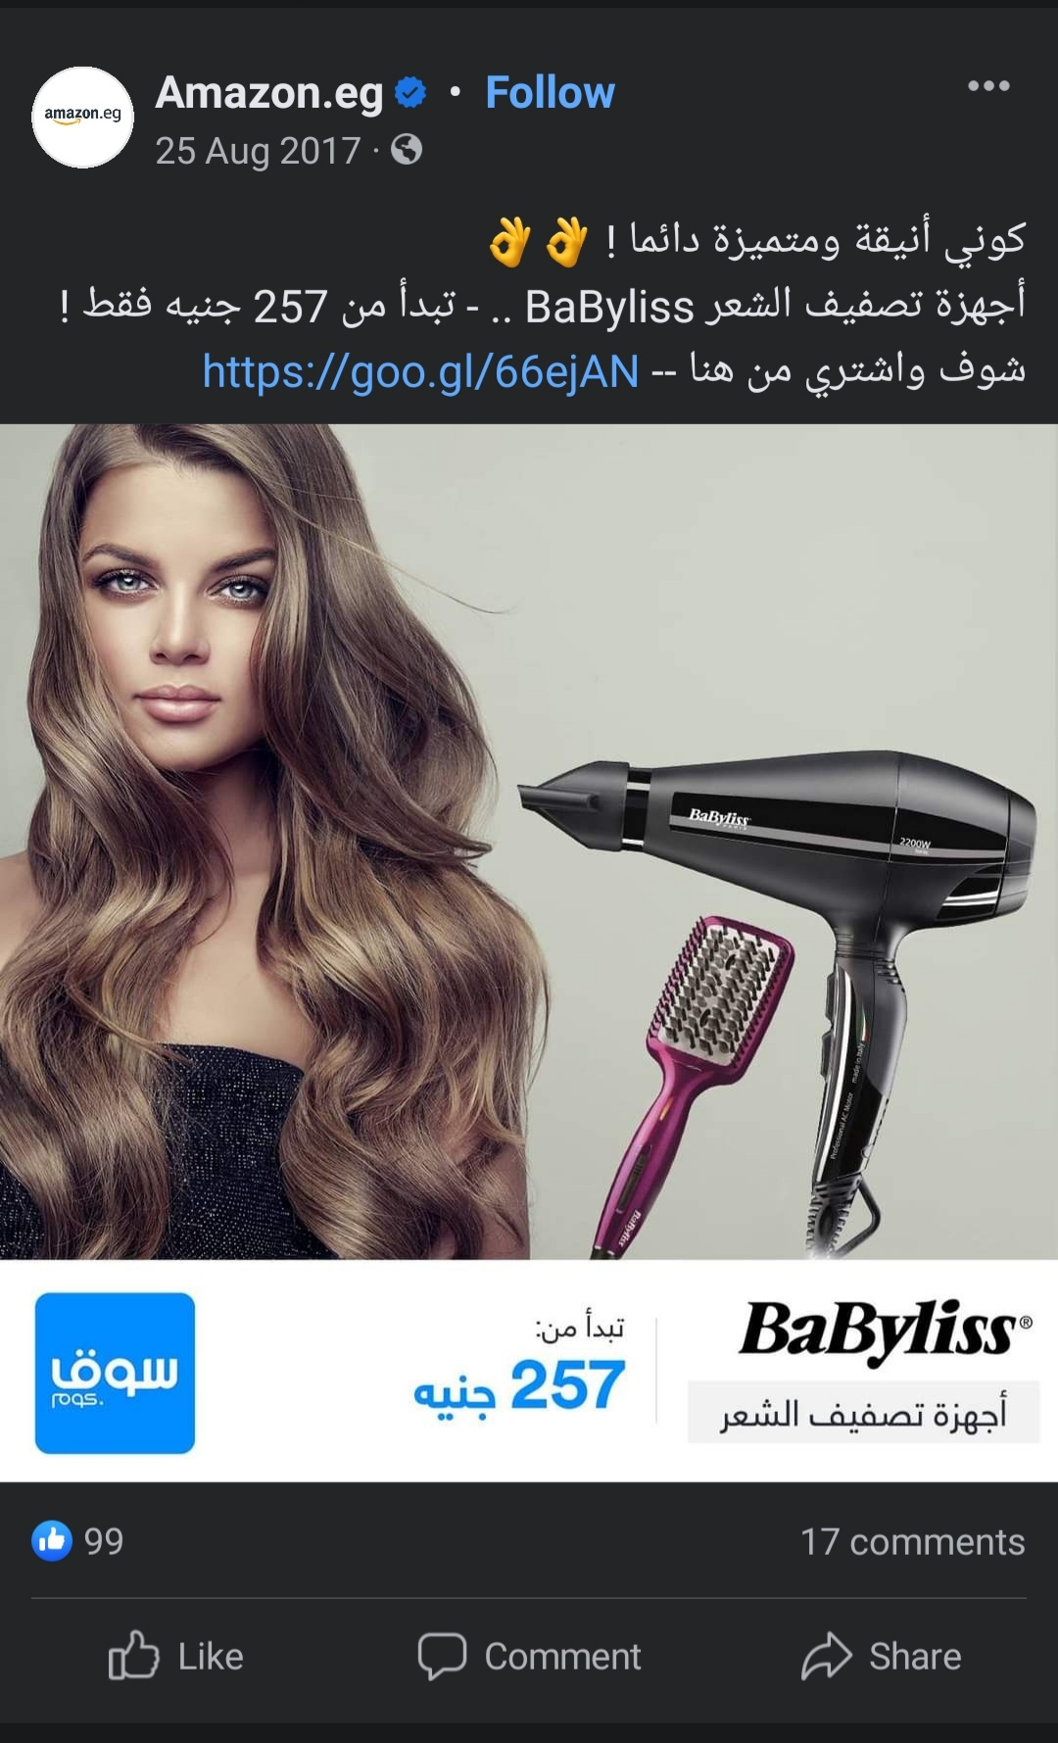
Social Media Marketing:

Slide 15
Content Marketing:

Slide 16



Slide 17



Slide 18
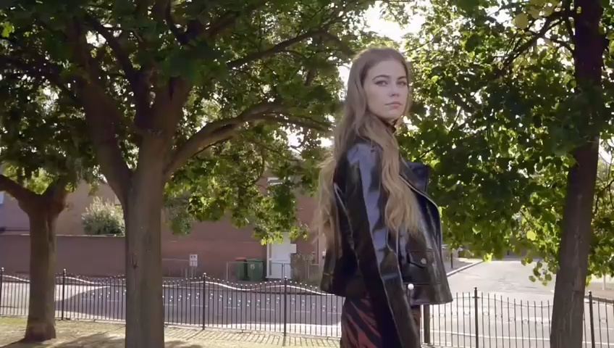

Slide 19
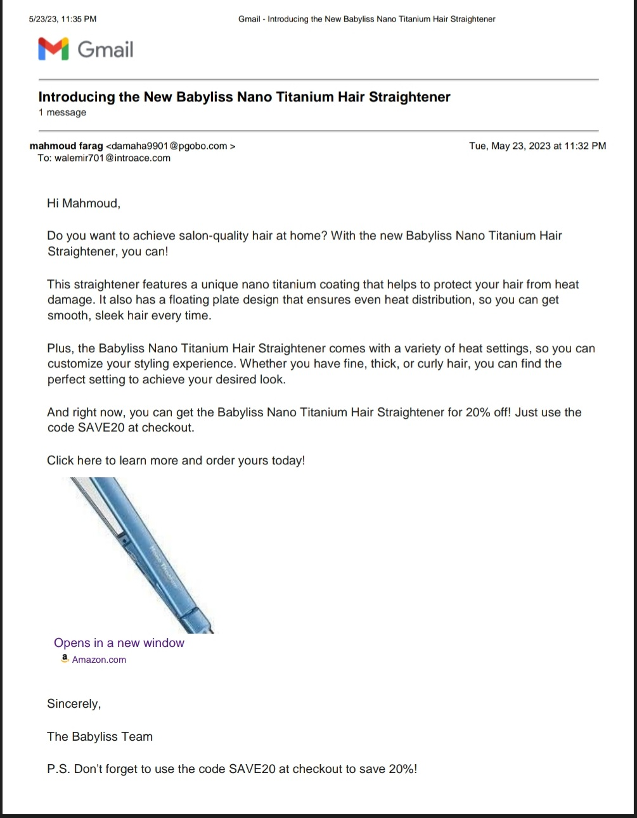
Email Marketing

Slide 20
Thank You

